Slide 1
18AIE332T - Image and Video Processing

Slide 2
Digital Image Fundamentals and Image Transforms
SYLLABUS
Fundamental steps in digital image processing
Components of an image processing system
Structure of human eye, Image formation
Brightness adaptation and discrimination
Basic concepts in sampling and Quantization , Representing digital images
Neighbors of a pixel, Adjacency, Connectivity, Regions and Boundaries
Distance Measures, A simple image formation model
Color fundamentals and models
Fourier transform of sampled functions
Sampling theorem, Aliasing, Obtaining the DFT from the Continuous Transform of a Sampled Function
Properties of 2D DFT
Relationship between spatial and frequency interval, Translation and Rotation, Periodicity, symmetric properties
Fast Fourier Transform FFT
Discrete Cosine Transform DCT
Discrete Wavelet Transform DWT
Some basic intensity transformation functions – image negatives
log transformations
Piecewise linear transformation functions

Slide 3
Learning Resources
Rafael C Gonzalez, Richard E Woods, “Digital Image Processing”- 3rd Edition, Pearson Education 2008.
2. Yao wang, JoemOstarmann and Ya – quin Zhang, ”Video processing and communication “,1st edition , PH Int.
3. M. Tekalp ,”Digital video Processing”, Prentice Hall International
4. A.K. Jain, “Fundamentals of Digital Image Processing”. Pearson education
5.William K Pratt, “Digital Image Processing”, John Willey (2001).

Slide 4
INTRODUCTION

Slide 5

What is a Digital Image?
A digital image is a representation of a two-dimensional image as a finite set of digital values, called picture elements or pixels
Notes:
Real world is continuous – an image is simply a digital approximation of this.

Slide 6

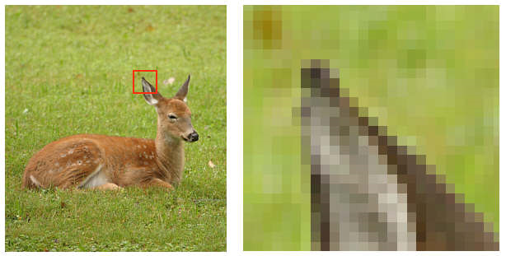
What is a Digital Image? (contd.)
Pixel values typically represent gray levels, colors, heights, opacities etc.
Remember digitization implies that a digital image is an approximation of a real scene
1 pixel

Slide 7
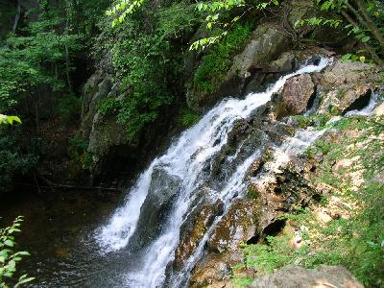
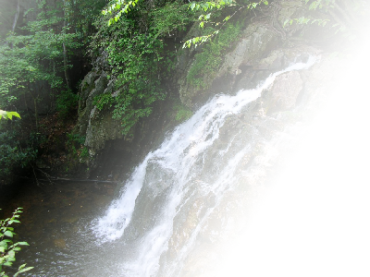
What is a Digital Image? (contd.)
Common image formats include:
1 sample per point (B&W or Grayscale)
3 samples per point (Red, Green, and Blue)
4 samples per point (Red, Green, Blue, and “Alpha”, a.k.a. Opacity)
For most of this course we will focus on grey-scale images

Slide 8
What is Digital Image Processing?
Digital image processing focuses on two major tasks
Improvement of pictorial information for human interpretation
Processing of image data for storage, transmission and representation for autonomous machine perception
Some argument about where image processing ends and fields such as image analysis and computer vision start

Slide 9
What is Digital Image Processing? (contd.)
The continuum from image processing to computer vision can be broken up into low-, mid- and high-level processes
Low Level Process
Mid Level Process
High Level Process
Input: Image Output: Image
Examples: Noise removal, image sharpening
Input: Image Output: Attributes
Examples: Object recognition, segmentation
Input: Attributes Output: Understanding
Examples: Scene understanding, autonomous navigation
Notes:
Give the analogy of the character recognition system.
Low Level: Cleaning up the image of some text
Mid level: Segmenting the text from the background and recognising individual characters
High level: Understanding what the text says

Slide 10
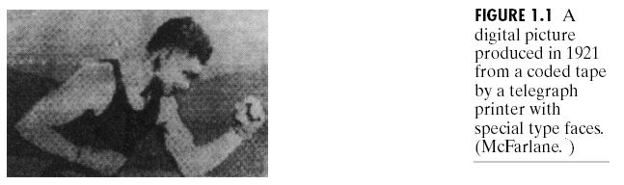
History of Digital Image Processing
Early 1920s: One of the first applications of digital imaging was in the news-paper industry
The Bartlane cable picture transmission service
Images were transferred by submarine cable between London and New York
Pictures were coded for cable transfer and reconstructed at the receiving end on a telegraph printer
Early digital image

Slide 11
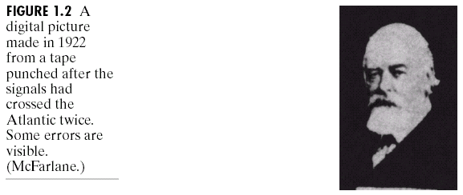
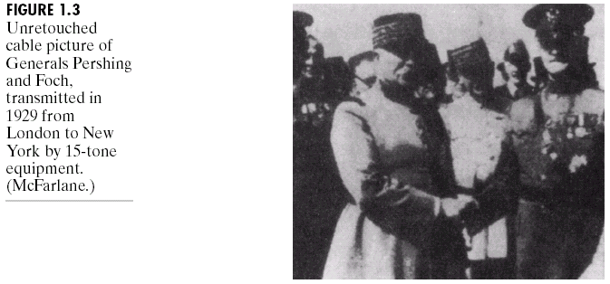
History of Digital Image Processing (contd.)
Mid to late 1920s: Improvements to the Bartlane system resulted in higher quality images
New reproduction processes based on photographic techniques
Increased number of tones in reproduced images
Improved digital image
Early 15 tone digital image

Slide 12
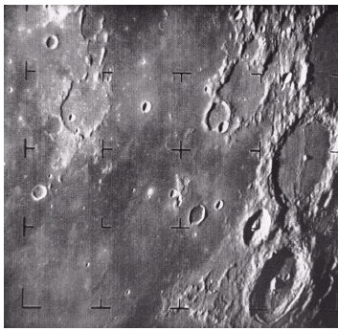
History of Digital Image Processing (contd.)
1960s: Improvements in computing technology and the onset of the space race led to a surge of work in digital image processing
1964: Computers used to improve the quality of images of the moon taken by the Ranger 7 probe
Such techniques were used in other space missions including the Apollo landings
A picture of the moon taken by the Ranger 7 probe minutes before landing

Slide 13
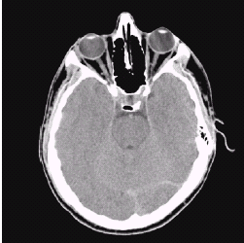
History of Digital Image Processing (contd.)
1970s: Digital image processing begins to be used in medical applications
1979: Sir Godfrey N. Hounsfield & Prof. Allan M. Cormack share the Nobel Prize in medicine for the invention of tomography, the technology behind Computerised Axial Tomography (CAT) scans
Typical head slice
CAT image

Slide 14
History of Digital Image Processing (contd.)
1980s - Today: The use of digital image processing techniques has exploded and they are now used for all kinds of tasks in all kinds of areas
Image enhancement/restoration
Artistic effects
Medical visualisation
Industrial inspection
Law enforcement
Human computer interfaces

Slide 15
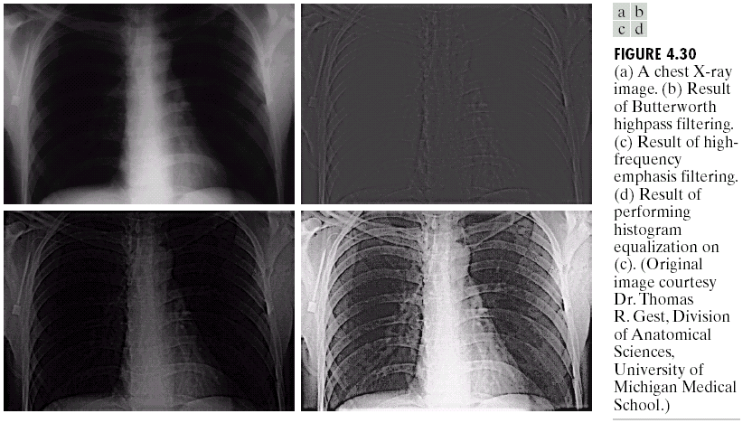
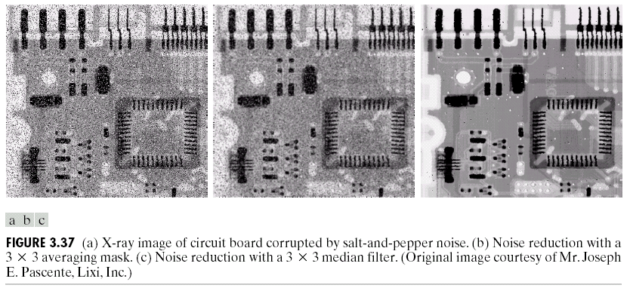
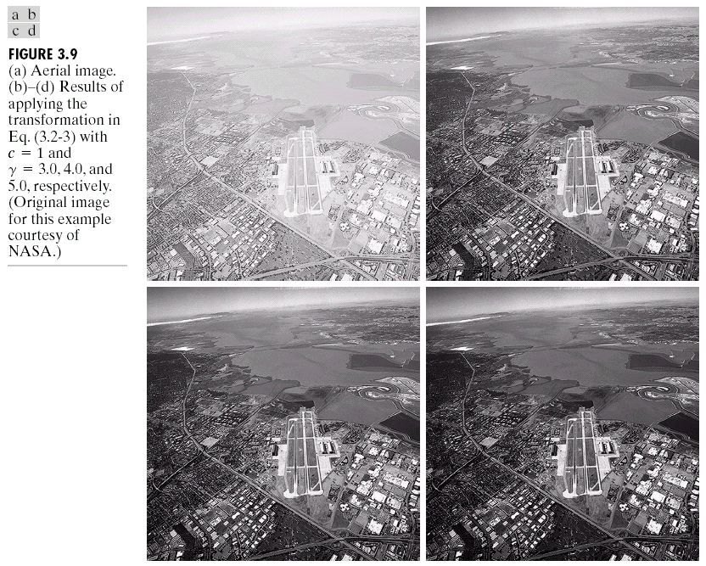
Applications: Image Enhancement
One of the most common uses of Digital Image Processing techniques: improve quality, remove noise etc

Slide 16
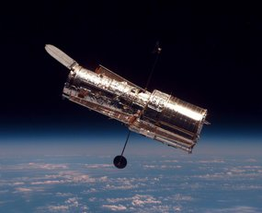
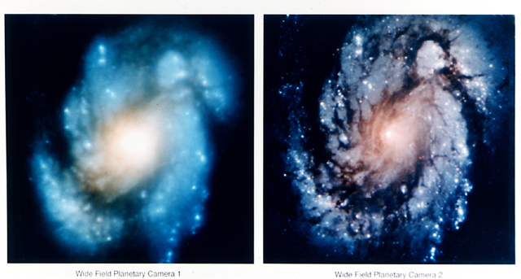
Applications: The Hubble Telescope
Launched in 1990 the Hubble telescope can take images of very distant objects
However, an incorrect mirror made many of Hubble’s images useless
Image processing techniques were used to fix this

Slide 17
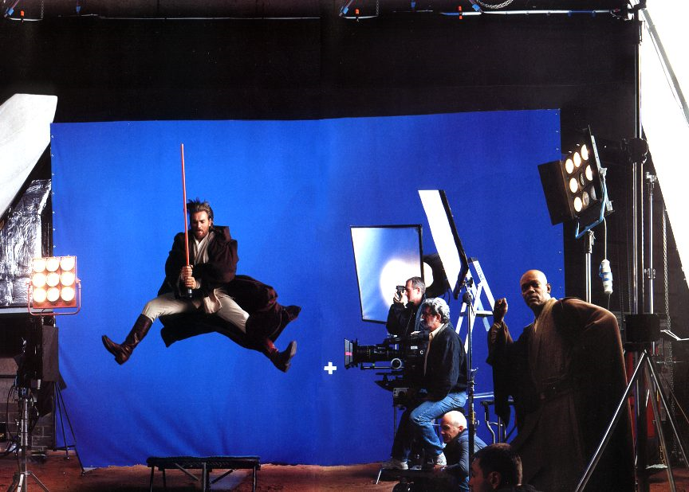
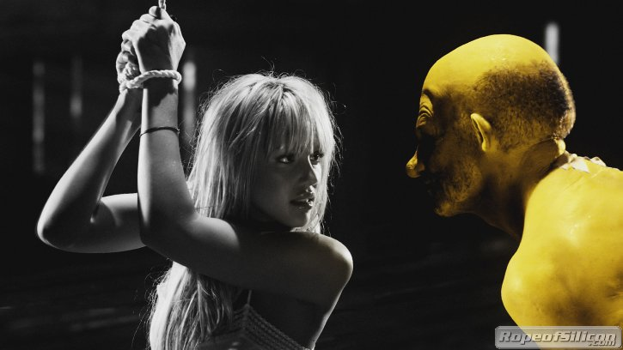
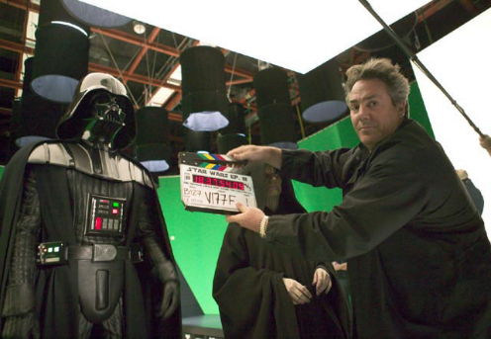
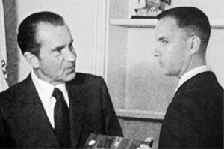
Applications: Artistic Effects
Artistic effects are used to make images more visually appealing, to add special effects and to make composite images

Slide 18
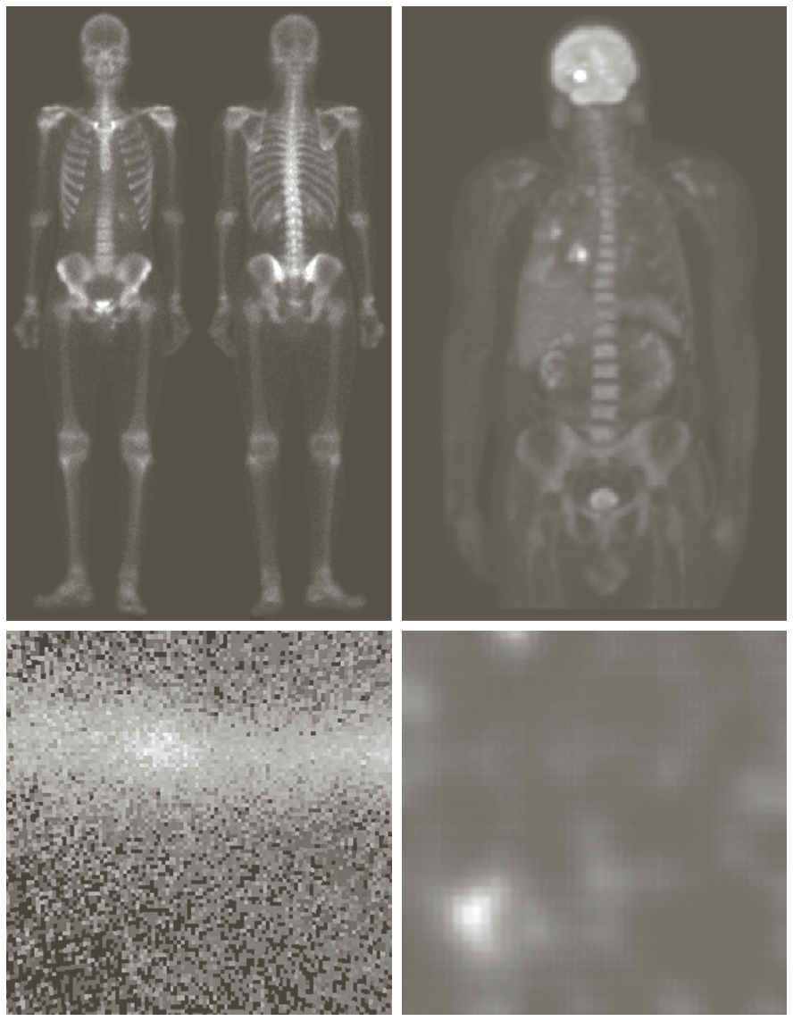
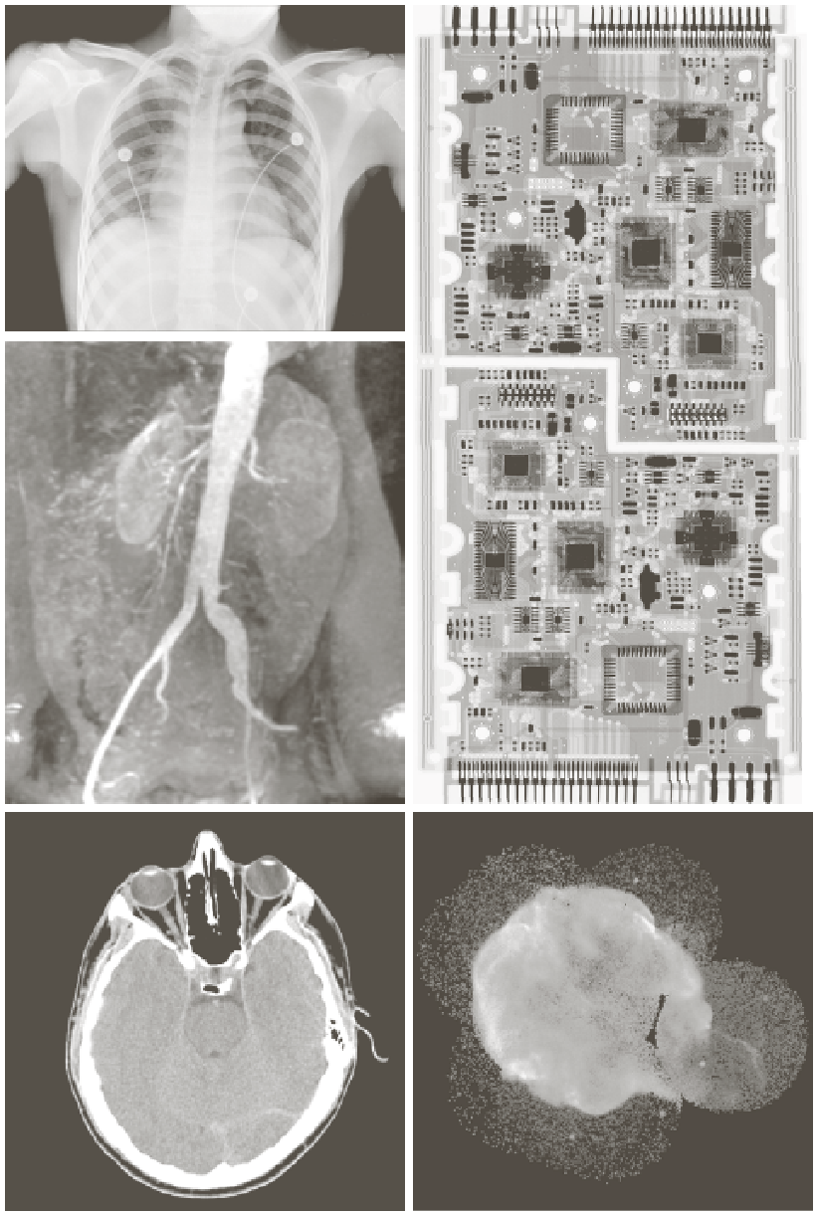
Applications: Medicine
X-ray imaging
Gamma-ray imaging

Slide 19
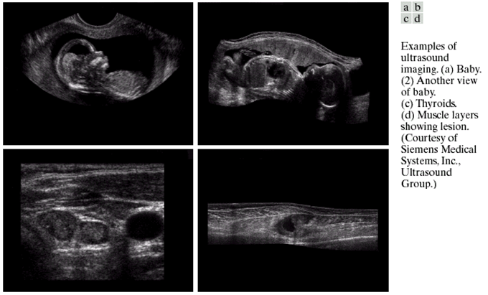
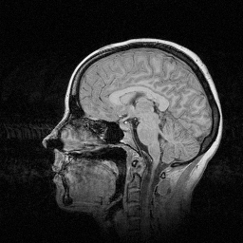
Applications: Medicine (contd.)
Magnetic Resonance Imaging (MRI)
Ultrasound

Slide 20
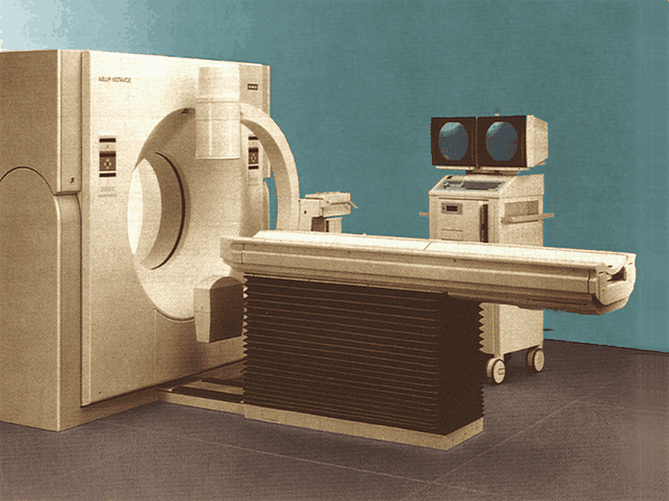
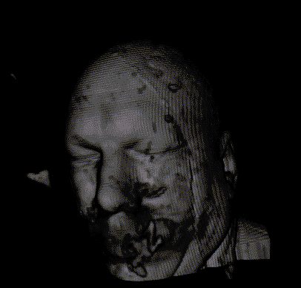
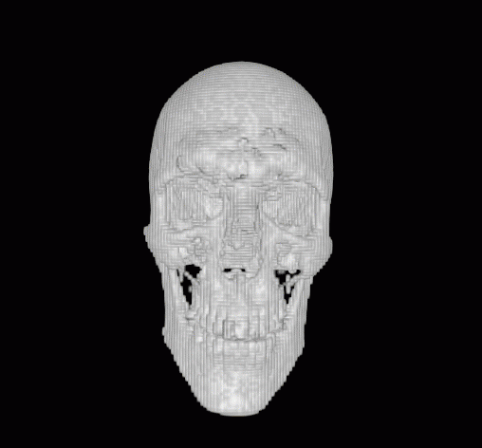
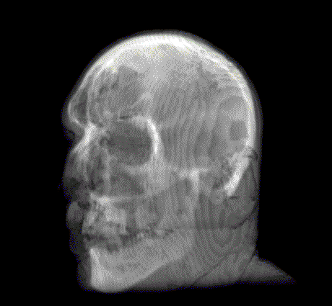
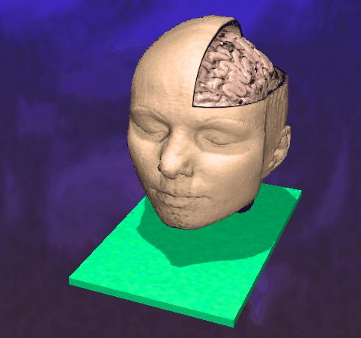
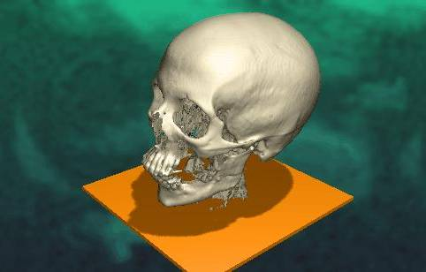
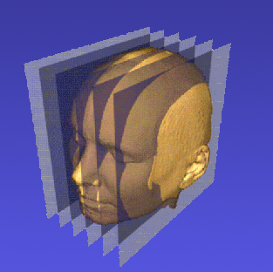
Applications: Medicine (contd.)
3D tomography and rendering with transparencies (1)
3D tomography and rendering with transparencies (2)

Slide 21
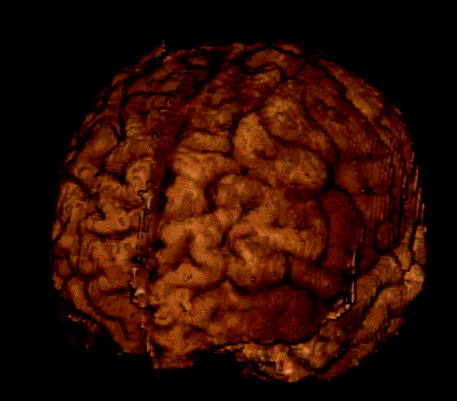
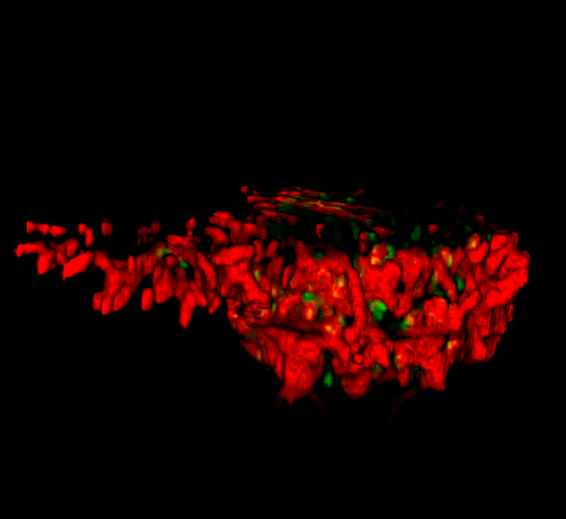
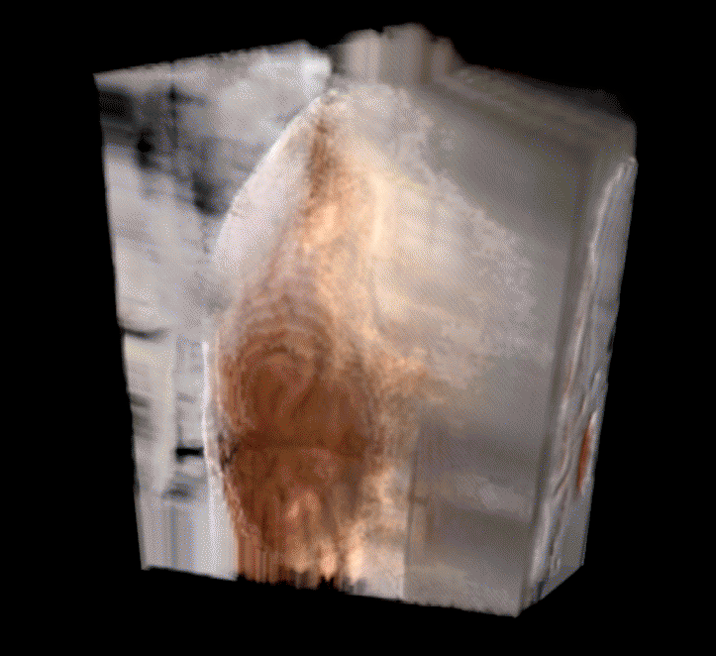
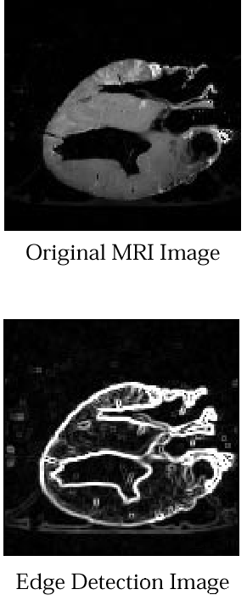
Applications: Medicine (contd.)
3D tomography and rendering with transparencies (3)
Human brain (128 cross-sections)
Cancer cell
(256 cross-sections)
Ice Block (Human brain) (128 cryo-sections)
Take slice from MRI scan of canine heart, and find boundaries between types of tissue Image with gray levels representing tissue density, Use a suitable filter to highlight edges
Original MRI Image of a Dog Heart
Edge Detection Image

Slide 22
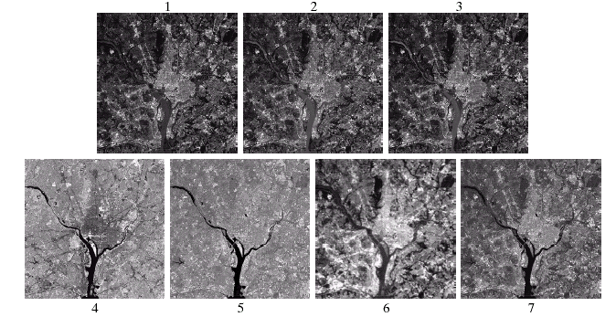
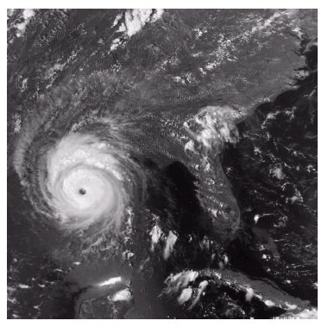
Applications: Geographic Information System (GIS)
Geographic Information Systems
Satellite imagery
Terrain classification (LANDSAT)
Meteorology (NOAA)

Slide 23
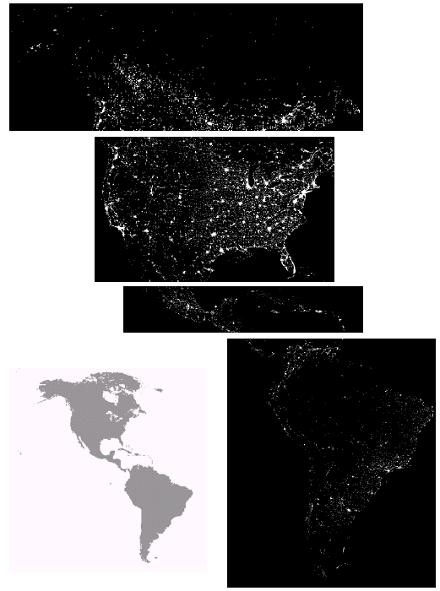
Applications: Geographic Information System (GIS) (Contd.)
Night-Time Lights of the World data set (infra red)
Global inventory of human settlement
Not hard to imagine the kind of analysis that might be done using this data

Slide 24
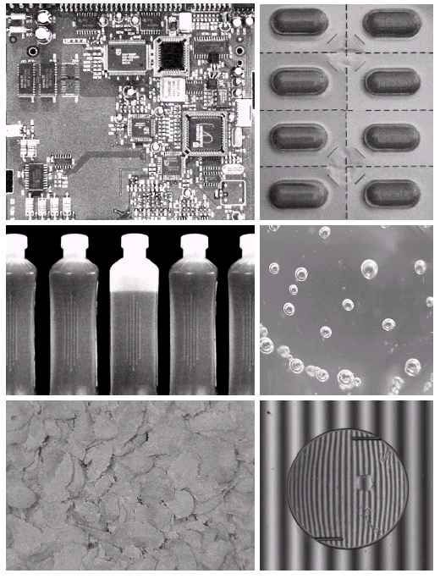
Applications: Industrial Inspection
Human operators are expensive, slow and unreliable
Make machines do the job instead
Industrial vision systems are used in all kinds of industries
Can we trust them?

Slide 25
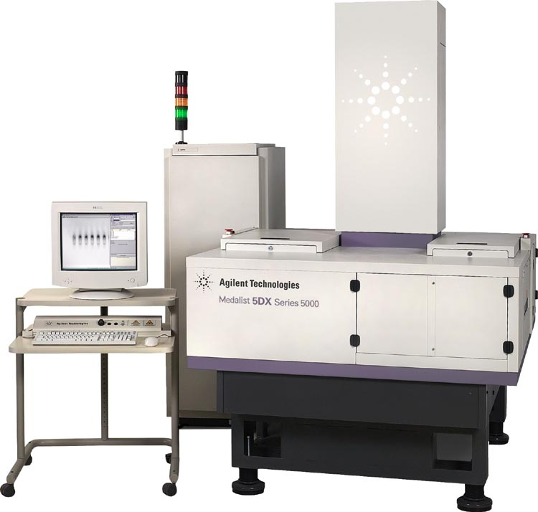
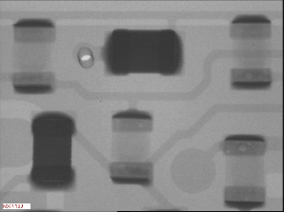
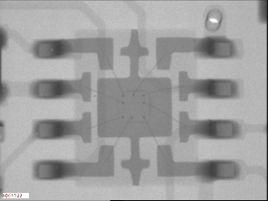
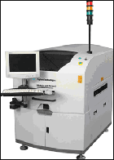
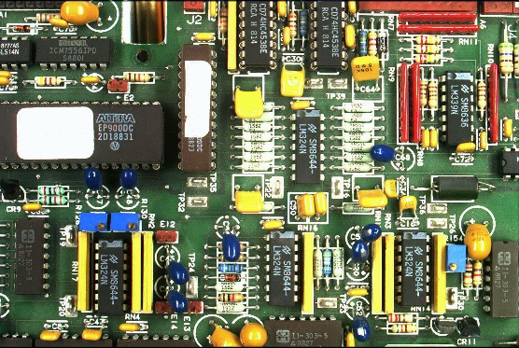
Applications: PCB Inspection
Printed Circuit Board (PCB) inspection
Machine inspection is used to determine that all components are present and that all solder joints are acceptable
Both conventional imaging and x-ray imaging are used

Slide 26
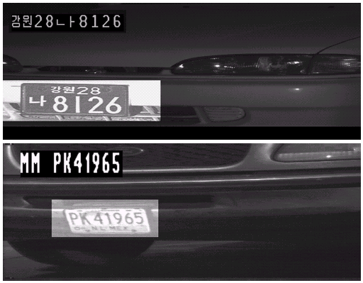
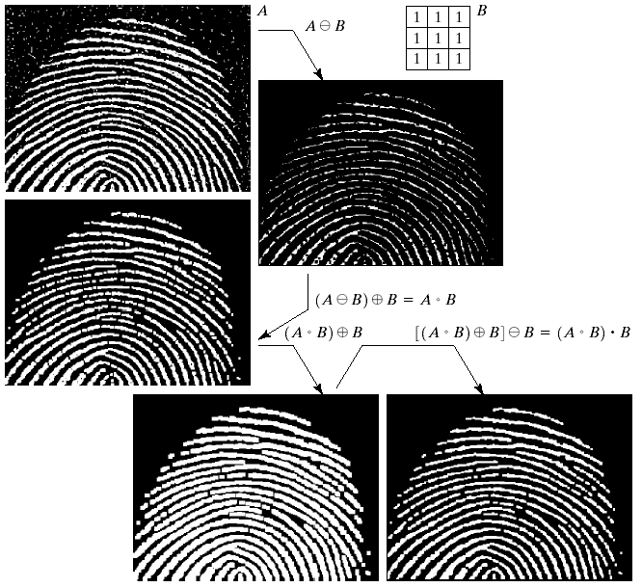
Applications: Law Enforcement
Image processing techniques are used extensively by law enforcers
Number plate recognition for speed cameras/automated toll systems
Fingerprint recognition
Enhancement of CCTV images

Slide 27
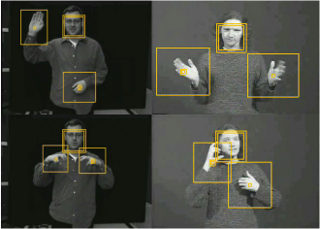

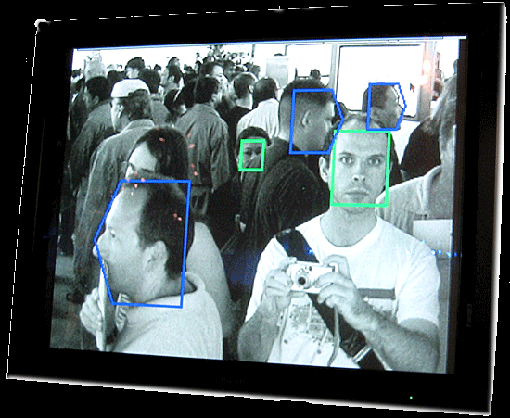
Applications: Human–computer interaction (HCI)
Try to make human computer interfaces more natural
Face recognition
Gesture recognition
Does anyone remember the user interface from “Minority Report”?
These tasks can be extremely difficult

Slide 28
Fundamental Steps in Digital Image Processing

Slide 29
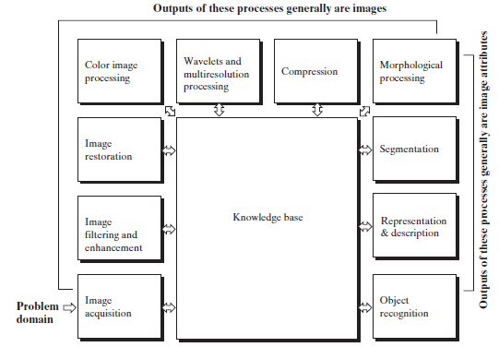
Fundamental Steps in Digital Image Processing

Slide 30
Fundamental Steps in Digital Image Processing (Contd.) Image Aquisition
Image Acquisition: The first step is to acquire a digital image using a digital camera, scanner, or any other image capture device.
The image can be obtained from various sources such as photographs, videos, or medical imaging devices.
Image Restoration
Morphological Processing
Image Enhancement
Segmentation
Image Acquisition
Object Recognition
Representation & Description
Problem Domain
Colour Image Processing
Image Compression

Slide 31
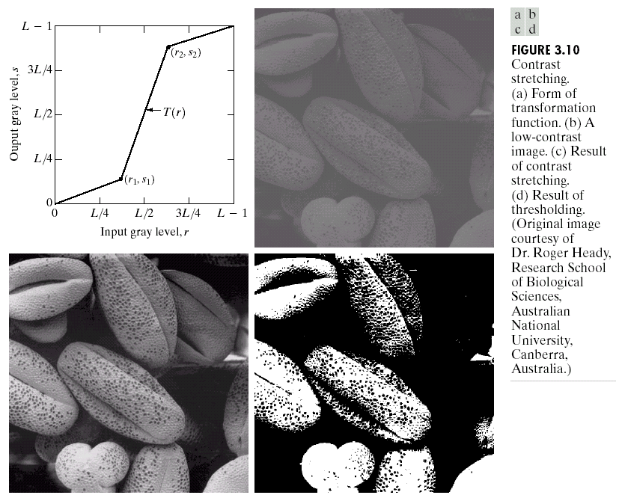
Fundamental Steps in Digital Image Processing (Contd.) Image Enhancement
Image Enhancement: Image enhancement techniques aim to improve the visual quality of the image or highlight specific features of interest.
Common enhancement techniques include filtering operations like sharpening, blurring, and noise reduction.
Other methods like contrast stretching, histogram modification, and spatial domain operations can also be applied.
Image Restoration
Morphological Processing
Image Enhancement
Segmentation
Image Acquisition
Object Recognition
Representation & Description
Problem Domain
Colour Image Processing
Image Compression

Slide 32
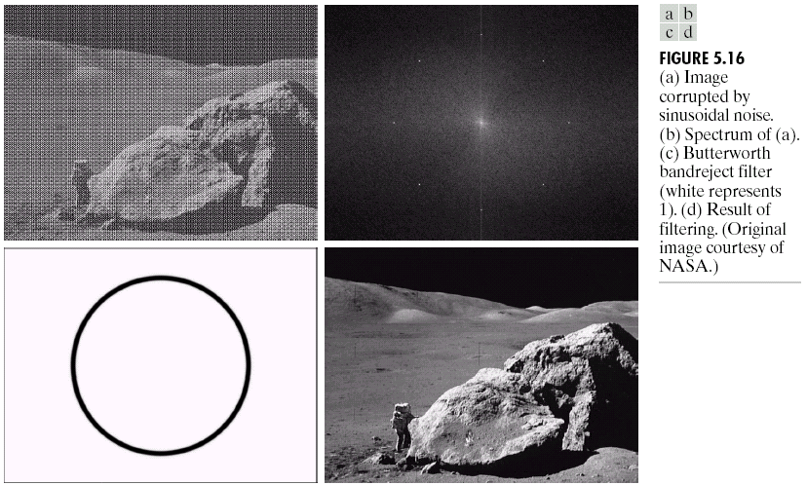
Fundamental Steps in Digital Image Processing (Contd.) Image Restoration
Image restoration is used to recover images that have been degraded by noise, motion blur, or other distortions.
It involves techniques such as image deblurring, denoising, and image inpainting to reconstruct the original image as accurately as possible.
Image Restoration
Morphological Processing
Image Enhancement
Segmentation
Image Acquisition
Object Recognition
Representation & Description
Problem Domain
Colour Image Processing
Image Compression

Slide 33
Fundamental Steps in Digital Image Processing (Contd.) Morphological Processing
Morphological processing is a fundamental technique in digital image processing that deals with the shape and structure of objects within an image.
It is based on mathematical morphology, which analyzes the geometrical properties of objects by using set theory and algebraic operations.
Morphological processing is particularly useful in tasks such as image segmentation, noise removal, object detection, and image analysis.
Image Restoration
Morphological Processing
Image Enhancement
Segmentation
Image Acquisition
Object Recognition
Representation & Description
Problem Domain
Colour Image Processing
Image Compression

Slide 34
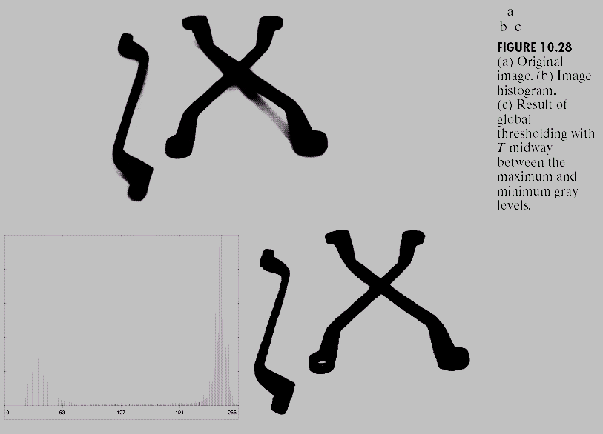
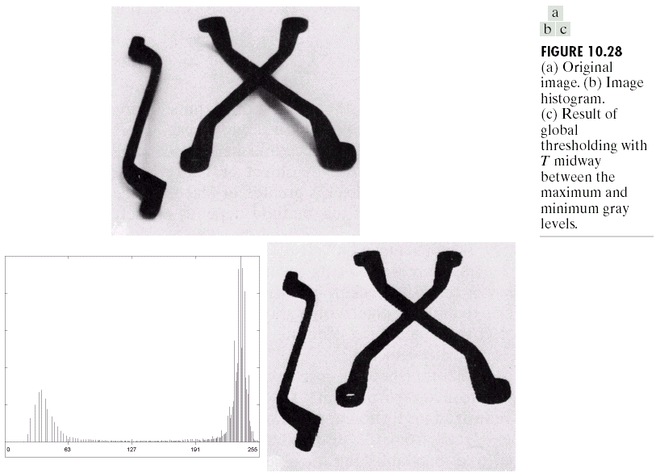
Fundamental Steps in Digital Image Processing (Contd.) Segmentation
Image segmentation involves partitioning an image into meaningful regions or objects.
It helps in object recognition, image understanding, and computer vision tasks.
Techniques like thresholding, region growing, edge detection, and clustering algorithms are used for segmentation.
Image Restoration
Morphological Processing
Image Enhancement
Segmentation
Image Acquisition
Object Recognition
Representation & Description
Problem Domain
Colour Image Processing
Image Compression

Slide 35

Fundamental Steps in Digital Image Processing (Contd.) Object Recognition
Object recognition is a computer vision task that involves identifying and classifying objects or specific patterns within digital images or video frames.
The goal is to enable machines to understand and interpret visual data, similar to how humans perceive and recognize objects in their surroundings.
Object recognition has numerous practical applications, including autonomous vehicles, surveillance systems, augmented reality, robotics, and image retrieval.
Image Restoration
Morphological Processing
Image Enhancement
Segmentation
Image Acquisition
Object Recognition
Representation & Description
Problem Domain
Colour Image Processing
Image Compression

Slide 36

Fundamental Steps in Digital Image Processing (Contd.) Representation & Description
Representation and description are crucial steps in the process of analyzing and interpreting digital images.
These steps involve transforming the raw pixel data into meaningful and informative representations that capture the essential characteristics of objects or regions of interest within an image
Image Restoration
Morphological Processing
Image Enhancement
Segmentation
Image Acquisition
Object Recognition
Representation & Description
Problem Domain
Colour Image Processing
Image Compression

Slide 37

Fundamental Steps in Digital Image Processing (Contd.) Image Compression
Image compression reduces the storage space required for images while minimizing the loss of visual quality.
Compression techniques such as JPEG (Joint Photographic Experts Group) and PNG (Portable Network Graphics) are widely used to achieve efficient storage and transmission of images.
Image Restoration
Morphological Processing
Image Enhancement
Segmentation
Image Acquisition
Object Recognition
Representation & Description
Problem Domain
Colour Image Processing
Image Compression

Slide 38

Fundamental Steps in Digital Image Processing (Contd.) Colour Image Processing
Color image processing involves the analysis, manipulation, and enhancement of images that contain color information.
It deals with images represented in color spaces such as RGB (Red, Green, Blue), CMYK (Cyan, Magenta, Yellow, Black), HSV (Hue, Saturation, Value), or other color models.
Color image processing techniques are used in various applications, including computer vision, medical imaging, remote sensing, and digital photography.
Image Restoration
Morphological Processing
Image Enhancement
Segmentation
Image Acquisition
Object Recognition
Representation & Description
Problem Domain
Colour Image Processing
Image Compression

Slide 39
Components of an Image Processing System

Slide 40

Components of an Image Processing System Image Sensors
Starting with image sensing, there are two elements required to acquire digital images.
The first is a physical device that is sensitive to the energy radiated by the object we wish to image.
The second, called a digitizer, is a device for converting the output of the physical sensing device into digital form.
For instance, in a digital video camera, the sensors produce an electrical output proportional to light intensity.
The digitizer converts these outputs to digital data

Slide 41

Components of an Image Processing System (Contd.) Specialized Image Processing hardware
Specialized image processing hardware usually consists of the digitizer just mentioned, plus hardware that performs other primitive operations, such as an arithmetic logic unit (ALU), that performs arithmetic and logical operations in parallel on entire images.
One example of how an ALU is used is in averaging images as quickly as they are digitized, for the purpose of noise reduction.
This type of hardware sometimes is called a front-end subsystem, and its most distinguishing characteristic is speed.
In other words, this unit performs functions that require fast data throughputs (e.g., digitizing and averaging video images at 30 frames/s) that the typical main computer cannot handle.

Slide 42

Components of an Image Processing System (Contd.) Computer
The computer in an image processing system is a general-purpose computer and can range from a PC to a supercomputer.
In dedicated applications, sometimes custom computers are used to achieve a required level of performance, but our interest here is on general-purpose image processing systems.
In these systems, almost any well-equipped PC-type machine is suitable for off-line image processing tasks.

Slide 43

Components of an Image Processing System (Contd.) Image Processing Software
Software for image processing consists of specialized modules that perform specific tasks.
A well-designed package also includes the capability for the user to write code that, as a minimum, utilizes the specialized modules.
More sophisticated software packages allow the integration of those modules and general-purpose software commands from at least one computer language.

Slide 44

Components of an Image Processing System (Contd.) Mass Storage
Mass storage capability is a must in image processing applications. An image of size pixels, in which the intensity of each pixel is an 8-bit quantity, requires one megabyte of storage space if the image is not compressed.
Digital storage for image processing applications falls into three principal categories:
short-term storage for use during processing, (Frame Buffer)
(2) on-line storage for relatively fast recall
(3) archival storage, characterized by infrequent access.

Slide 45

Components of an Image Processing System (Contd.) Image Displays
Image displays in use today are mainly color (preferably flat screen) TV monitors.
Monitors are driven by the outputs of image and graphics display cards that are an integral part of the computer system.
Seldom are there requirements for image display applications that cannot be met by display cards available commercially as part of the computer system.
In some cases, it is necessary to have stereo displays, and these are implemented in the form of headgear containing two small displays embedded in goggles worn by the user.

Slide 46

Components of an Image Processing System (Contd.) Hardcopy
Hardcopy devices for recording images include laser printers, film cameras, heat-sensitive devices, inkjet units, and digital units, such as optical and CDROM disks.
Film provides the highest possible resolution, but paper is the obvious medium of choice for written material.
For presentations, images are displayed on film transparencies or in a digital medium if image projection equipment is used.
The latter approach is gaining acceptance as the standard for image presentations.

Slide 47

Components of an Image Processing System (Contd.) Networking
Networking is almost a default function in any computer system in use today.
Because of the large amount of data inherent in image processing applications, the key consideration in image transmission is bandwidth.
In dedicated networks, this typically is not a problem, but communications with remote sites via the Internet are not always as efficient.
Fortunately, this situation is improving quickly as a result of optical fiber and other broadband technologies.

Slide 48
Self Test Questions
1. Which step involves extracting relevant information or features from an image?
a) Image Enhancement
b) Image Restoration
c) Image Segmentation
d) Feature Extraction
Answer: d) Feature Extraction
2. What is the process of assigning labels or class identities to objects in an image called?
a) Image Recognition
b) Image Analysis
c) Image Compression
d) Image Segmentation
Answer: a) Image Recognition
3. Which step involves presenting processed images or analysis results in a visually meaningful form?
a) Image Visualization
b) Image Analysis
c) Image Restoration
d) Image Enhancement
Answer: a) Image Visualization
4. What is the final step in digital image processing?
a) Image Acquisition
b) Image Enhancement
c) Image Analysis
d) Image Visualization
Answer: d) Image Visualization

Slide 49
Self Test Questions
5. Which component of an image processing system captures images from various sources?
a) Image Analysis Algorithms
b) Preprocessing Components
c) Image Acquisition Devices
d) User Interface
Answer: c) Image Acquisition Devices
6. Which step involves converting an image from one color space to another?
a) Image Acquisition
b) Image Compression
c) Color Image Processing
d) Image Analysis
Answer: c) Color Image Processing
7. Which step involves partitioning an image into meaningful regions or objects?
a) Image Acquisition
b) Image Segmentation
c) Image Restoration
d) Image Analysis
Answer: b) Image Segmentation
8. What is the process of recovering images that have been degraded by noise or distortions called?
a) Image Compression
b) Image Segmentation
c) Image Restoration
d) Image Recognition
Answer: c) Image Restoration

Slide 50
Self Test Questions
9. What is the first step in digital image processing?
a) Image Enhancement
b) Image Acquisition
c) Image Compression
d) Image Analysis
Answer: b) Image Acquisition
10. Which step in digital image processing involves reducing noise and enhancing image quality?
a) Image Segmentation
b) Image Enhancement
c) Image Compression
d) Image Recognition
Answer: b) Image Enhancement
11. What are the names of the various color image processing categories?
a) Pseudo-color and Multi-color processing
b) Half-color and pseudo-color processing
c) Full-color and pseudo-color processing
d) Half-color and full-color processing
Answer: c) Full-color and pseudo-color processing
12. Which of the following process helps in Image enhancement?
a) Digital Image Processing
b) Analog Image Processing
c) Both a and b
d) None of the above
Answer: c) Both a and b

Slide 51
Thank You

